Slide 1
Module-1:
Python Basic Concepts and Programming

Slide 2
Module-1: Python Basic Concepts and Programming :
Interpreter, Parts of Python Programming Language, Identifiers, Keywords, Statements and Expressions, Variables, Operators, Precedence and Associativity, Data Types, Indentation, Comments, Program Execution, Reading Input, Print Output, Type Conversions, The type( ) Function and Is Operator, Control Flow Statements, The if Decision Control Flow Statement, The if…else Decision Control Flow Statement, The if…elif…else Decision Control Statement, Nested if Statement, The while Loop, The for Loop, The continue and break Statements, Sequences – Strings, Built-In Functions, Commonly Used Modules, Function Definition and Calling the Function, The return Statement and void Function, Scope and Lifetime of Variables, Default Parameters, Keyword Arguments, *args and **kwargs, Command Line Arguments.

Slide 3
Python Tokens:
In Python, tokens are the smallest units of the program that have a meaningful role. Python breaks every program into these tokens during the lexical analysis phase.
There are 5 types of Python tokens:
Keywords
Identifiers
Literals
String Literals
Numeric Literals
Boolean Literals
Special Literal (None)
Collection Literals
Operators
Punctuators

Slide 4
What is Python:
Python is an general purpose, Object-oriented, High-level, Dynamically Typed, Compiled and Interpreted programming language known for its simplicity and readability.
Common Uses of Python:
Web Development: Using frameworks like Django and Flask.
Data Analysis and Visualization: With libraries like Pandas, Matplotlib, and Seaborn.
Artificial Intelligence and Machine Learning: Leveraging tools like TensorFlow, PyTorch, and Scikit-learn.
Automation/Scripting: Automating repetitive tasks using Python scripts.
Game Development: Using libraries like Pygame.
Scientific Computing: Libraries like SciPy and SymPy are used for simulations and computations.
Software Development: For prototyping and backend development.

Slide 5
Interpretation in Python
The bytecode produced by the compilation step is executed by the Python Virtual Machine (PVM). The PVM interprets the bytecode line by line and executes it. This is what gives Python its "interpreted" behavior.
Key Points
Python is not a purely compiled language like C or C++, where code is compiled into machine code before execution.
Python is not a purely interpreted language like early versions of BASIC, which execute source code directly without compiling it.
Instead, Python uses a hybrid model: it compiles source code to bytecode (a form of intermediate code), which is then interpreted.

Slide 6
How Python is Compiled and Interpreted:
Python is often described as both a compiled and an interpreted language, depending on how you look at its execution process.
Compilation in Python:
When you run a Python program, it first goes through a compilation step.
The Python interpreter compiles the source code (.py file) into bytecode (a lower-level, platform-independent representation). This bytecode is stored in .pyc files (in the __pycache__ directory).
Note:
This compilation step is implicit and happens behind the scenes.
The bytecode is not directly executed by your machine; it is executed by the Python interpreter.

Slide 7
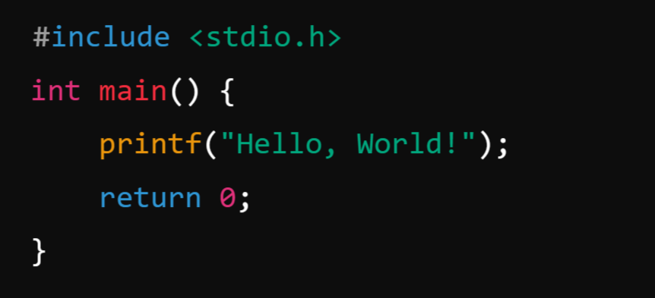
What is Compiler?
A compiler is a program that translates the entire source code of a programming language into machine code or intermediate code before execution. The compiled code is then executed directly by the computer's processor.
Example: C Language
Process: A C compiler (like GCC) compiles the code into a machine-readable .exe file, which can then be executed.

Slide 8

What is Interpreter?
An interpreter is a program that executes code line by line, translating it directly into machine code as it runs.
Example: Python:
Process: The Python interpreter reads the script line by line and executes it immediately.

Slide 9
Parts of Python Programming Language:
Python programming language consists of several essential components and parts that work together to provide its functionality and versatility.
Identifiers
Keywords
Statements and Expressions
Variables
Operators
Precedence and Associativity
Data Types
Indentation
Comments
Program Execution
Reading Input and Print Output

Slide 10
Identifiers:
Identifiers in Python are name given to the programming elements such as variables, functions, classes, or other objects. They serve as labels to reference these objects in code.
Python has specific rules and conventions for creating identifiers.
Example for Identifiers: Valid Identifiers:
my_variable
Variable123
_privateVar
MyClass

Slide 11
Rules for Creating Identifiers
1. Allowed Characters:
Identifiers can only contain letters (a-z, A-Z), digits (0-9), and underscores (_).
They cannot start with a digit. For example, 123abc is invalid, but abc123 is valid.
2. Case Sensitivity: Identifiers are case-sensitive. For example, MyVariable and myvariable are treated as distinct identifiers.
3. Keywords: Identifiers cannot be the same as Python's reserved keywords (e.g., if, while, class, def, etc.). Use the keyword module to view the list of reserved keywords in Python
4. Special Characters: Identifiers cannot include special characters like @, $, %, or spaces.
5. Length: Identifiers can be of any length, but it’s good practice to keep them concise and meaningful.
6. Underscore Usage:
A single leading underscore (_var): Used to indicate a private variable (not enforced by Python, but by convention).
Double leading underscores (__var): Used for name mangling in classes to avoid name conflicts in child.
Double underscores at both ends (__init__): Reserved for special methods or magic methods in Python.

Slide 12
Example for Invalid Identifiers:
123abc (Starts with a digit)
my-variable (Contains a hyphen)
class (Reserved keyword)
my variable (Contains a space)

Slide 13
Keywords:
Keywords in Python are reserved words that have a specific meaning and purpose in the language. They are part of Python's syntax and cannot be used as identifiers (e.g., variable names, function names, or class names).
Python keywords are case-sensitive and must be used exactly as defined.
Characteristics of Keywords:
Fixed Meaning: The meaning of a keyword is predefined and cannot be changed.
Case-Sensitive: Keywords must be used in lowercase (e.g., if is valid, but If is not).
Reserved: They cannot be used for naming variables, functions, or any other identifiers.

Slide 14
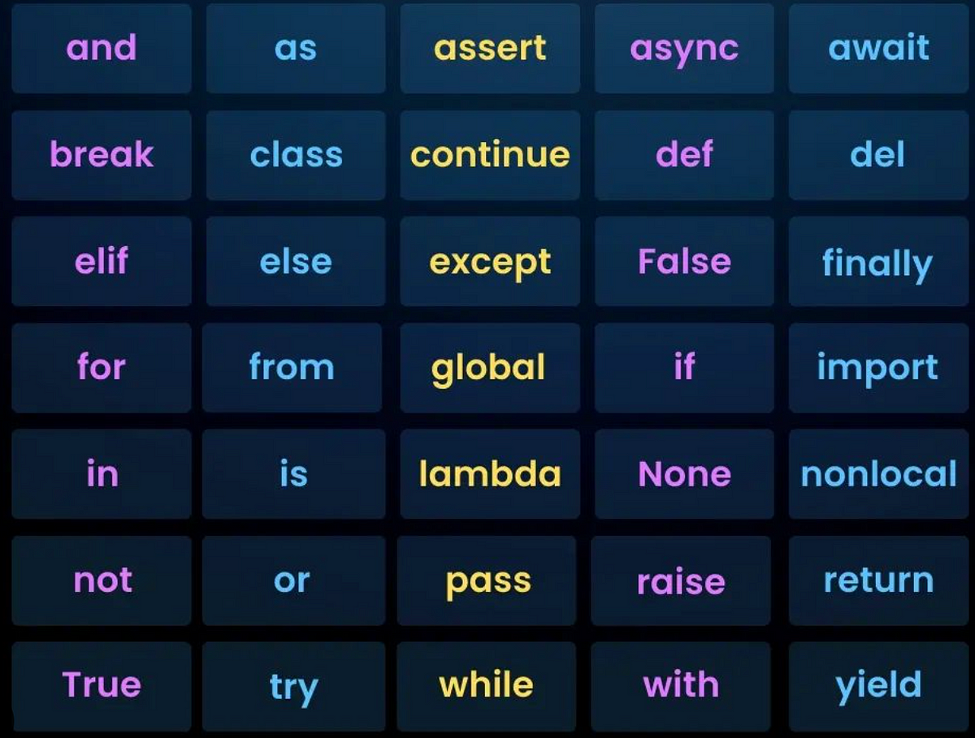
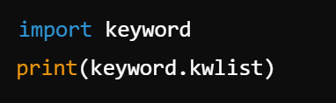
List of Keywords:
Python has a predefined set of keywords. You can get the current list of keywords using the keyword module:

Slide 15
Statements and Expressions:
In Python, statements and expressions are fundamental building blocks of the language. They serve different purposes and are essential for writing functional and efficient code.
Expressions:
An expression is a combination of values, variables, and operators. A value all by itself is considered an expression, and so is a variable.
Characteristics of Expressions:
Always return a value.
Can be part of a larger statement.
Examples include mathematical operations, function calls, or logical comparisons.

Slide 16
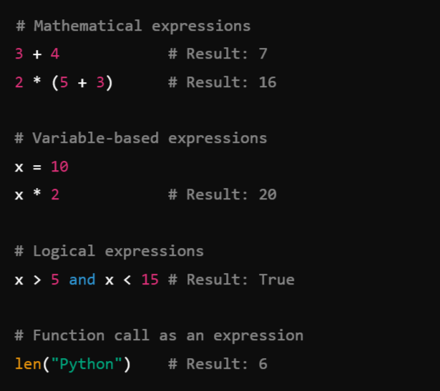
Example:
When you type an expression at the prompt, the interpreter evaluates it, which means that it finds the value of the expression.
In this example, x has the value 10 and x * 2 has the value 20.

Slide 17
Statements:
A statement is an instruction that Python executes. Statements may or may not produce a result, and they define the flow of a program.
A statement is a unit of code that has an effect, like creating a variable or displaying a value.
Characteristics of Statements:
Do not necessarily return a value.
Perform actions such as defining variables, loops, or conditionals.
Can include expressions as part of their structure.
Types of Statements:
Assignment Statement: Assigns a value to a variable.
Control Flow Statements: Includes if, for, while, etc.
Function and Class Definitions: def, class.
Import Statements: import, from.

Slide 18
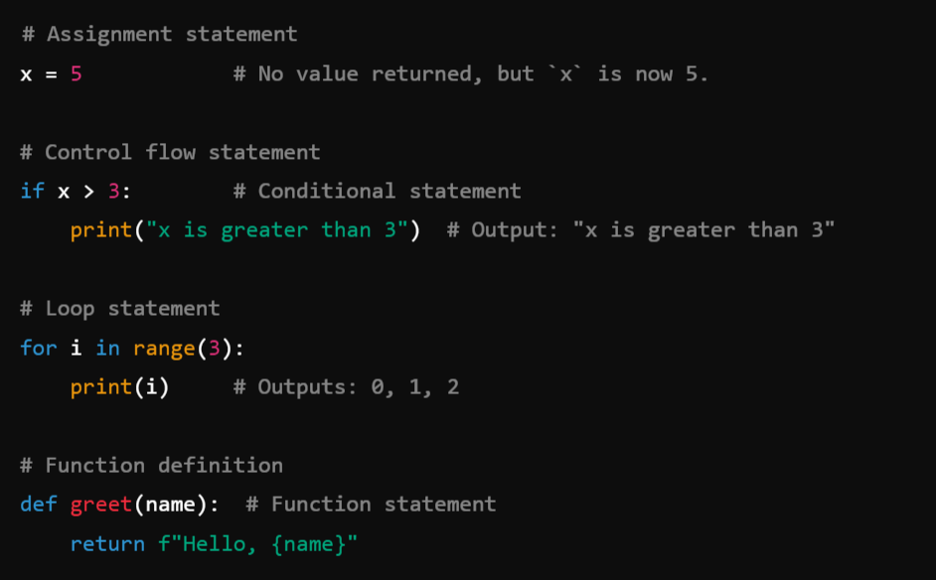
Example:

Slide 19
Key Differences Between Statements and Expressions:
Aspect | Expression | Statement
Definition | A combination of values and operators. | A complete instruction or action.
Returns a Value | Always returns a value. | May or may not return a value.
Examples | 5 + 3, x * 2, len("text") | x = 5, if, for, def, print()
Purpose | Produces a value. | Performs an action.

Slide 20
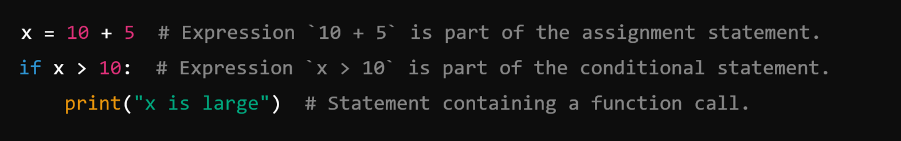
Expressions as Part of Statements: Expressions are often embedded within statements.
For example:
Summary:
Expressions: Produce values and can be part of a larger statement.
Statements: Perform actions and may contain expressions within them.

Slide 21
Variables:
In Python, variables are symbolic names that are used to reference objects in memory.
They are essentially labels that point to data stored in memory, enabling you to access and manipulate that data.
Variables are fundamental in programming and are used to store information that can be retrieved or modified during program execution.

Slide 22
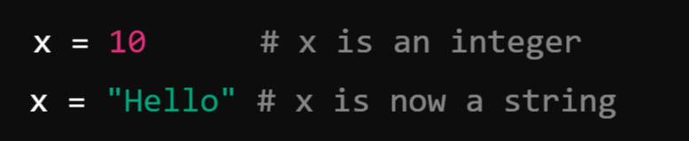
Key Characteristics of Variables in Python:
1. Dynamic Typing:
Python is a dynamically-typed language, meaning you do not need to declare the type of a variable explicitly. The type is inferred based on the value assigned to the variable.
Example:
2. No Explicit Declaration: Variables are created when you assign a value to them as Python is Dynamically Typed Language as compared to C and Java as they are statically Typed Languages.
3. Variable Naming Convention: As Variable is an Identifier, So it should follow the Rules for Creating Identifiers.
4. Memory Management: Python uses a garbage collector to manage memory automatically. Variables point to objects in memory, and when an object is no longer referenced, it is garbage collected.

Slide 23
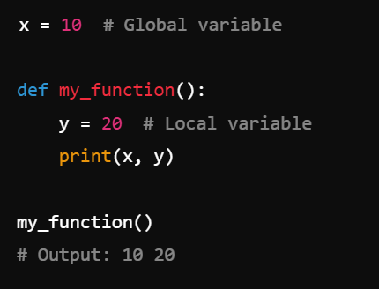
Global and Local Variables:
Global Variables: Defined outside a function and accessible throughout the program.
Local Variables: Defined inside a function and accessible only within that function.
Example:

Slide 24
Comments:
In Python, comments are lines of text within the code that are ignored by the Python interpreter. They are used to explain, document, and improve the readability of the code, making it easier for others (and yourself) to understand what the code does.
As programs get bigger and more complicated, they get more difficult to read. Formal languages are dense, and it is often difficult to look at a piece of code and figure out what it is doing, or why.
For this reason, it is a good idea to add notes to your programs to explain in natural language what the program is doing. These notes are called comments, and they start with the # symbol:

Slide 25
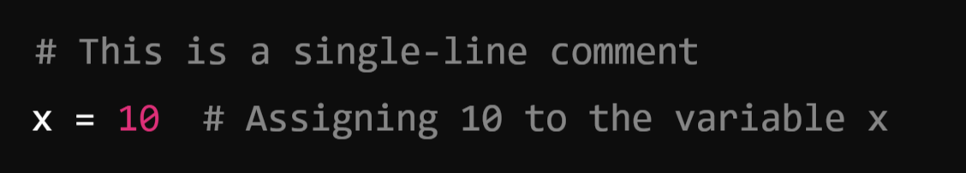
Types of Comments in Python
1. Single-Line Comments:
Begin with a hash symbol (#) and extend to the end of the line.
Used for brief explanations or notes.
Example:

Slide 26
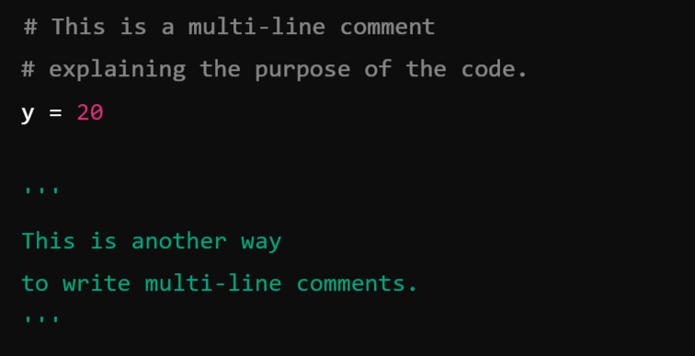
2. Multi-Line Comments:
Python does not have a special syntax for multi-line comments.
Instead, multi-line comments are achieved by using:
Multiple single-line comments.
Triple-quoted strings (''' or """) that are not assigned to any variable.
These are often used for longer explanations or temporary disabling of blocks of code.
Example:

Slide 27
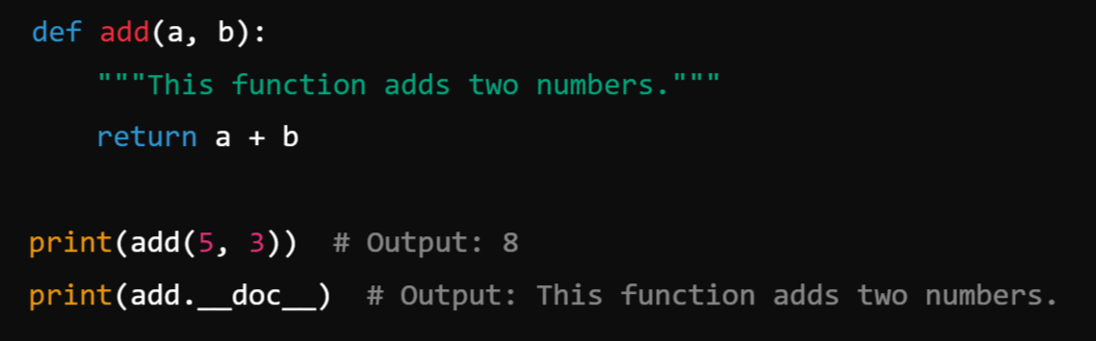
3. Documentation Strings (Docstrings):
Triple-quoted strings (“”” or ‘’’)placed at the beginning of a module, class, or function to describe its purpose.
These are not technically comments but serve a similar purpose.
Accessible via the help() function in Python.
Example:

Slide 28
How to generate doc string using help:
In Python, you can generate and view docstrings using the help() function. A docstring is a special string that documents a module, class, method, or function. It is enclosed within triple quotes (""" or ''') and is the first statement inside the function, class, or module.
Steps to Generate Docstrings Using help():
Write a docstring for your function, class, or module.
Call the help() function with the object (function, class, or module) as an argument to display the docstring.

Slide 29
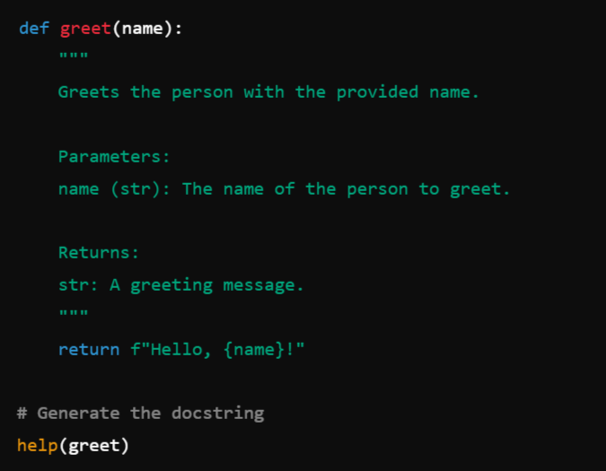
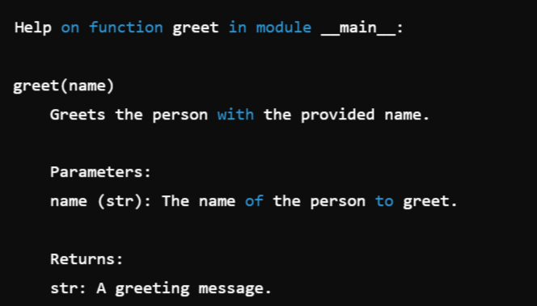
Example:
Output:

Slide 30
Operators in Python:
In Python, an operator is a symbol that performs operations on one or more operands. Operands are the values on which the operator operates. Operators are used to manipulate data and variables.
In Python, operators are categorized based on the number of operands they operate on, including:
Unary Operators: An operator which operates on only 1 operand is called Unary.
Binary Operators: An operator which operates on 2 operands is called Binary
Arithmetic Operators
Relational Operators
Logical Operators
Assignment Operators
Bitwise Operators
Ternary Operator: An operator which operates on 3 operand is called Ternary.

Slide 31
Unary Operators: Which operates on only one single Operand.
Operator | Description | Example
+ | Unary positive (identity) | +5 → 5
- | Unary negation | -5 → -5
~ | Bitwise NOT (1's complement) | ~5 → -6
not | Logical negation | not True → False

Slide 32
2. Binary Operators: Operates on two operands
1. Arithmetic Operators: These are used for performing mathematical calculations.
Operator | Name | Example | Description (a = 5 b = 3)
+ | Addition | a + b → 8 | Adds two values
- | Subtraction | a - b → 2 | Subtracts second from first
* | Multiplication | a * b → 15 | Multiplies two values
/ | Division | a / b → 2.5 | Divides first by second
% | Modulus | a % b → 2 | Returns the remainder
** | Exponentiation | a ** b → 125 | Raises first to power of second
// | Floor Division | a // b → 2 | Returns quotient without remainder

Slide 33
2. Relational or Comparison Operators:
Relational operators in Python are used to compare two values and return a boolean result (true or false).
Operator | Name | Example | Description (a = 5 b = 3)
== | Equal to | a == b → False | Checks if values are equal
!= | Not equal to | a != b → True | Checks if values are not equal
> | Greater than | a > b → True | Checks if first is greater
< | Less than | a < b → False | Checks if first is smaller
>= | Greater than or equal | a >= b → True | Checks if first is greater or equal
<= | Less than or equal | a <= b → False | Checks if first is smaller or equal

Slide 34
3. Logical Operators:
Logical operators in Python are used to perform logical operations on boolean expressions. They are commonly used in conditional statements to combine multiple conditions.
Operator | Name | Example | Description (a = 5 b = 3)
and | Logical AND | (a > 1 and b < 5) → True | Returns True if both conditions are True
or | Logical OR | (a > 1 or b > 5) → True | Returns True if one condition is True
not | Logical NOT | not(a > 5) → True | Negates the result of the condition

Slide 35
4. Assignment Operators: These are used to assign values to variables and can combine with arithmetic/bitwise operators.
Operator | Name | Example | Equivalent To
= | Assign or Simple Assignment | a = b | a = b
+= | Add and assign | a += b | a = a + b
-= | Subtract and assign | a -= b | a = a - b
*= | Multiply and assign | a *= b | a = a * b
/= | Divide and assign | a /= b | a = a / b
&= | Bitwise AND and assign | a &= b | a = a & b

Slide 36
5. Bitwise Operators:
Bitwise operators in Python perform bit-level operations on integer types (int, long, short, char, byte). These operators work directly on the binary representation of numbers.
Operator | Name | Example | Description (a = 5 b = 3)
& | Bitwise AND | a & b → 1 | Sets bit to 1 if both bits are 1
` | ` | Bitwise OR | `a
^ | Bitwise XOR | a ^ b → 6 | Sets bit to 1 if bits are different
~ | Bitwise NOT | ~a → -6 | Inverts all bits
<< | Left Shift | a << 1 → 10 | Shifts bits to the left by n places
>> | Right Shift | a >> 1 → 2 | Shifts bits to the right by n places

Slide 37
Truth Table:
&
2. |
3. ~
4. ^
A | B | A & B
0 | 0 | 0
0 | 1 | 0
1 | 0 | 0
1 | 1 | 1
A | !A
0 | 1
1 | 0
A | B | A | B
0 | 0 | 0
0 | 1 | 1
1 | 0 | 1
1 | 1 | 1
A | B | A | B
0 | 0 | 0
0 | 1 | 1
1 | 0 | 1
1 | 1 | 0

Slide 38
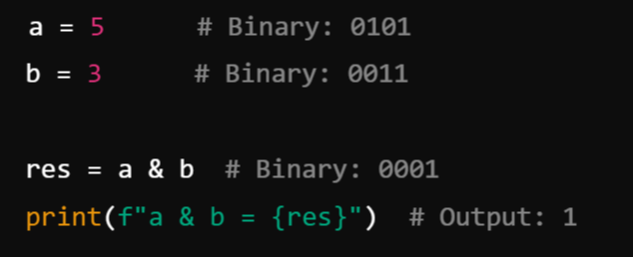
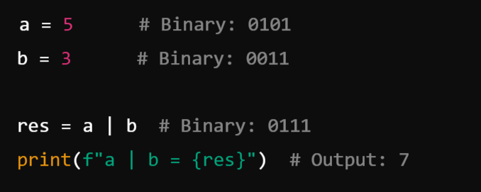
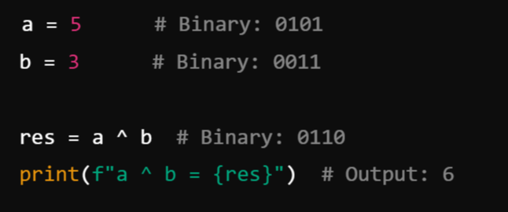
Example:
&
|
^

Slide 39
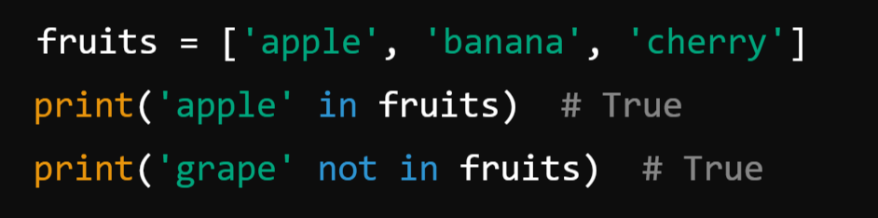
6. Membership Operators: These are used to test membership in sequences (e.g., strings, lists, tuples).
Example:
Operator | Name | Example | Description
in | Membership | 'a' in 'apple' → True | Returns True if value is in the sequence
not in | Not Membership | 'x' not in 'apple' → True | Returns True if value is not in sequence

Slide 40
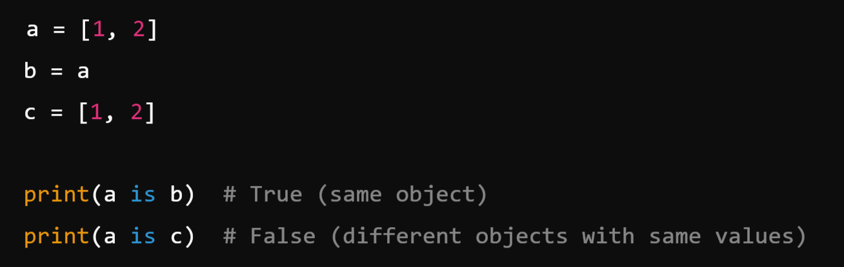
7. Identity Operators: These are used to compare memory locations of two objects.
Example:
Operator | Name | Example | Description
is | Identity | a is b | Returns True if objects are identical
is not | Not Identity | a is not b | Returns True if objects are not identical

Slide 41
Summary:
Category | Examples
Arithmetic | +, -, *, /, %, **, //
Comparison | ==, !=, >, <, >=, <=
Logical | and, or, not
Bitwise | &, `
Assignment | =, +=, -=, *=, /=, &=
Membership | in, not in
Identity | is, is not

Slide 42
3. Ternary Operator
The ternary operator in Python, also known as the conditional operator, is a shorthand for an if-else statement. It has three operands and is used to evaluate a condition and return one of two values, depending on whether the condition is true or false.
Ternary operators operate on three operands. Python supports the ternary operator through a concise if-else conditional expression.
Syntax:
Where,
condition: This is a boolean expression that evaluates to either true or false.
Value_if_true: This is the value returned if the condition is true.
Value_if_false: This is the value returned if the condition is false.

Slide 43
Example:
Condition | Ternary Expression | Result
x > 5 (True) | "Greater" if x > 5 else "Smaller" | Greater
x == 5 (False) | "Equal" if x == 5 else "Not Equal" | Not Equal

Slide 44
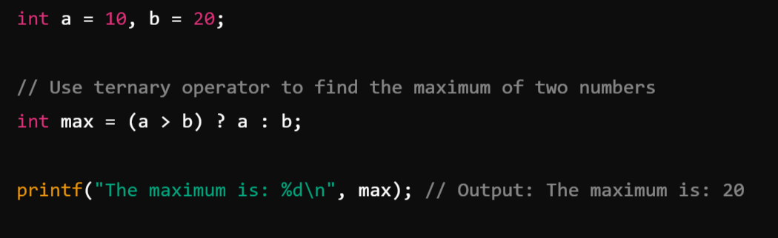
Example:

Slide 45
Operator Hierarchy
Precedence and Associativity

Slide 46
Precedence and Associativity:
Precedence:
Precedence or Hierarchy refers to the order in which operators are evaluated in an expression when there are multiple operators present. So, it determines the order in which operators are evaluated in an expression. Operators with higher precedence are evaluated before operators with lower precedence.
Associativity:
Associativity defines the direction in which operators of the same precedence level are evaluated in an expression. If operators have the same precedence, their associativity determines the order of evaluation.
Associativity can be either:
Left-to-Right Associativity: Operators are evaluated from left to right. This is common for most operators.
For example, in the expression a - b - c, subtraction is evaluated as (a - b) - c.
Right-to-Left Associativity: Operators are evaluated from right to left. This is less common and is typically seen with assignment (=) and ternary (?:) operators.
For example, in the expression a = b = c, the assignment is evaluated as a = (b = c).

Slide 47
Precedence and Associativity:
Precedence | Operators | Description | Associativity
1 | () | Parentheses | Left-to-right
2 | ** | Exponentiation | Right-to-left
3 | +x, -x, ~x | Unary operators (positive, negative, bitwise NOT) | Right-to-left
4 | *, /, //, % | Multiplication, division, floor division, modulus | Left-to-right
5 | +, - | Addition, subtraction | Left-to-right
6 | <<, >> | Bitwise shift operators | Left-to-right
7 | & | Bitwise AND | Left-to-right
8 | ^ | Bitwise XOR | Left-to-right
9 | ` | ` | Bitwise OR
10 | ==, !=, >, <, >=, <= | Comparison operators | Left-to-right
11 | not | Logical NOT | Right-to-left
12 | and | Logical AND | Left-to-right
13 | or | Logical OR | Left-to-right
14 | =, +=, -=, *=, /=, //=, %= | Assignment operators | Right-to-left

Slide 48
Example:
result = 10 + 20 * 2 / 4; // Result will be 20
result = (10 + 20) * (2 / 4); // Result will be 15
result = 10 > 5 == 5 < 3;
result = (10 == 10) & (5 < 3);
int a = 10;
int b = 5;
int result = a += b * 2;

Slide 49
Data Types:
In Python, data types represent the kind or type of value stored in a variable. Python is Dynamically Typed Language, meaning variables don’t need explicit type declarations—they infer the type from the assigned value.
In Python, data types can be broadly categorized into:
Primitive or Built-In (Basic) types
Non-Primitive (Derived or Composite) types

Slide 50
1. Primitive Data Types (Basic Types):
Primitive data types are the most basic, built-in types that serve as the building blocks for data manipulation. These are immutable (cannot be changed after creation).
These Includes:
Numeric or Number Type
int
float
complex
Text Type (String)
Boolean Type (True or False)
None Type (None)

Slide 51
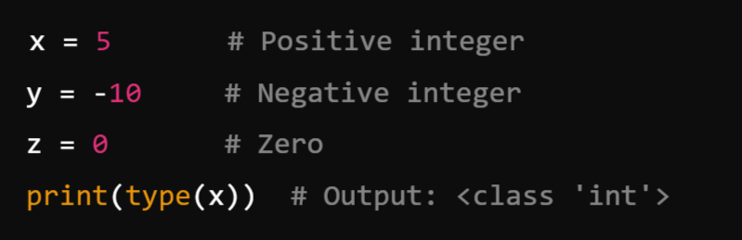
1. Numeric Types: Python provides 3 basic types for working with numbers:
a) int (Integer)
Represents whole numbers (positive, negative, or zero) without fractional parts.
Unlimited precision (size only limited by memory).
Examples:

Slide 52
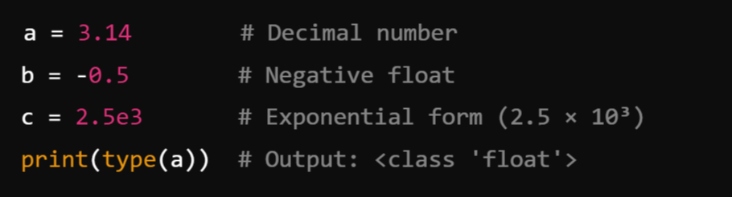
b) float (Floating-Point Number):
Represents numbers with a decimal point or in exponential notation (scientific notation).
Approximation to real numbers, with a fixed precision.
Examples:

Slide 53
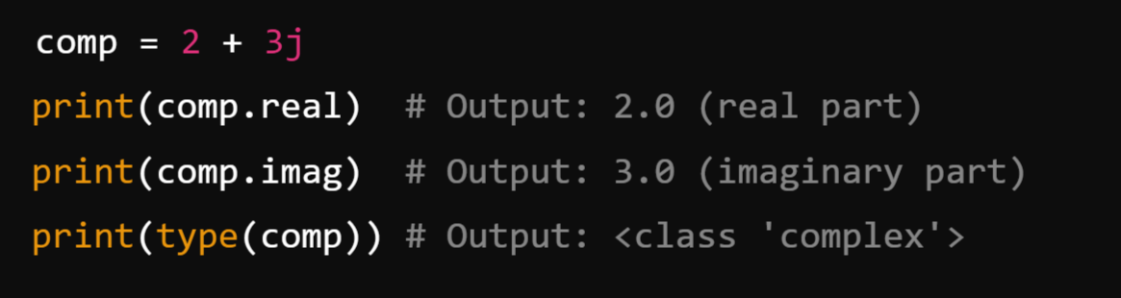
c) complex (Complex Number): complex type makes it easy to work with complex numbers.
It Represents numbers in the form a + bj, where:
a is the real part (float).
b is the imaginary part (float).
Used for mathematical computations.
Examples:

Slide 54
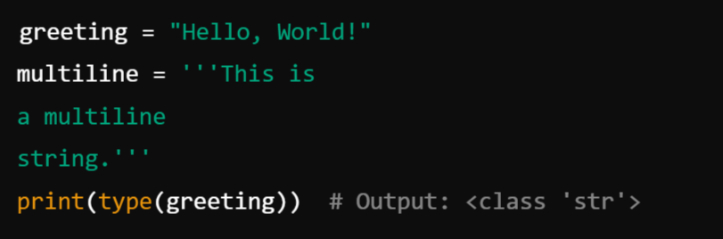
2. Text Type (String or Char): str
Represents sequences of characters (text data).
Enclosed in single ('), double ("), or triple quotes (''' or """).
Examples:

Slide 55
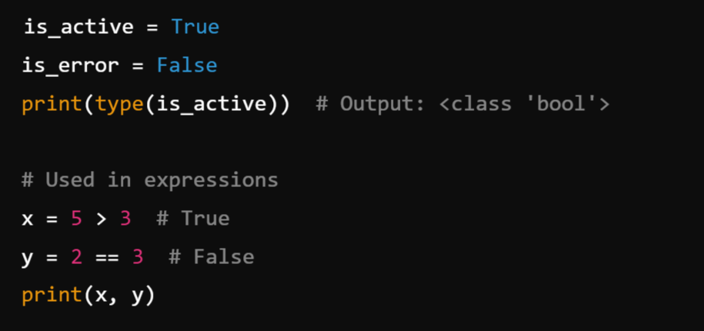
3. Boolean Type (bool):
Represents logical values: True or False.
Often used in conditional statements and logical operations.
Examples:

Slide 56
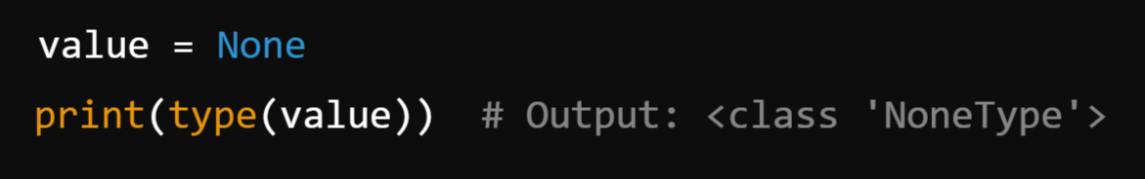
4. None Type
Represents the absence of a value or a null value.
Denoted by the keyword None.
Examples:

Slide 57
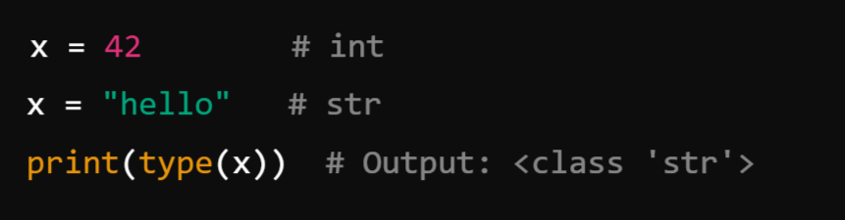
Key Characteristics of Primitive Types:
Immutable: Once created, their value cannot be changed (e.g., changing a string or number creates a new object in memory).
Type Inference: Python automatically detects the type when a value is assigned to a variable.
Dynamic Typing: Variables can change type during execution

Slide 58
2. Non-Primitive Data Types (Composite Types):
Non-Primitive Data Types (Composite Types) in Python are more complex and built using primitive types. They allow for grouping, organizing, and manipulating multiple values. These types can hold collections of values or structured data, making them essential for handling real-world problems.
These Includes:
Sequence Types
list
tuple
Range
2. Set Types
set
Frozenset
3. Mapping Types (dict)
4. Binary Types
bytes
bytearray

Slide 59
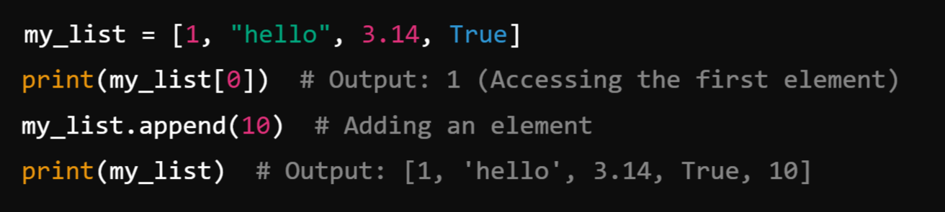
1. Sequence Types: Sequences are ordered collections of items. Python provides several sequence types:
a) list:
A mutable, ordered collection of items.
Can hold elements of different data types (Heterogeneous).
Syntax: Enclosed in square brackets [].

Slide 60
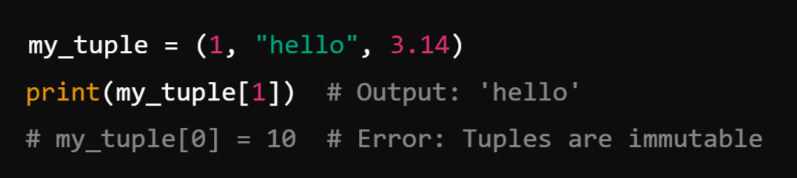
b) tuple:
An immutable, ordered collection of items.
Useful for fixed data structures.
Syntax: Enclosed in parentheses ().
Examples:

Slide 61
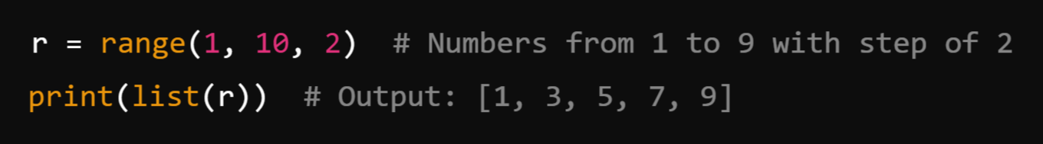
c) range
Represents a sequence of numbers.
Commonly used in loops.
Syntax: range(start, stop, step).
Examples:

Slide 62
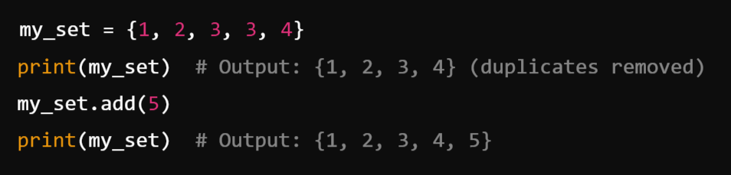
2. Set Types: Sets are unordered collections of unique elements.
a) set:
Mutable, unordered collection of unique items.
Syntax: Enclosed in curly braces {}.
Examples:

Slide 63
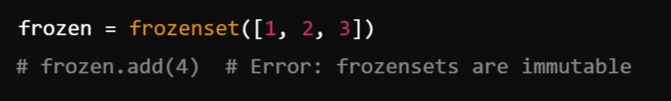
b) frozenset:
Immutable version of a set.
Syntax: Created using frozenset() function.
Examples:

Slide 64
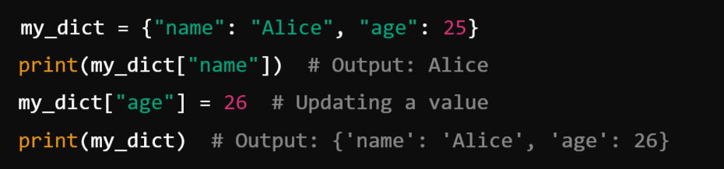
3. Mapping Types (dict): Mappings store data in key-value pairs.
Mutable, unordered collection of key-value pairs.
Keys must be unique and immutable; values can be any type.
Syntax: Enclosed in curly braces {}.
Examples:

Slide 65
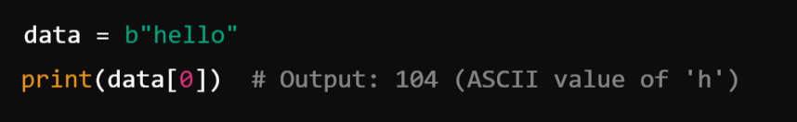
4. Binary Types:
Binary types deal with data in bytes, often used for file handling or low-level data manipulation.
a) bytes
Immutable sequence of bytes.
Syntax: b"...".
Examples:

Slide 66
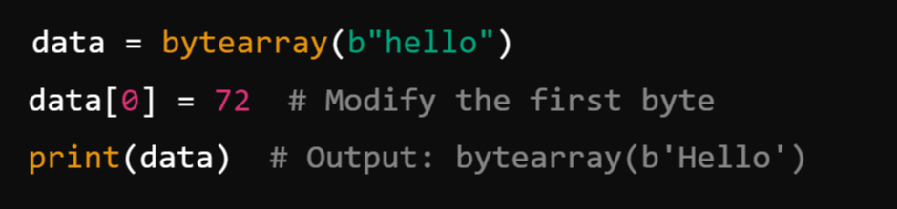
b) bytearray
Mutable sequence of bytes.
Syntax: bytearray(b"...").
Examples:

Slide 67
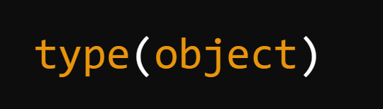
The type( ) Function and Is Operator:
type() Function in Python:
The type() function in Python is a built-in function used to determine the type of an object. It helps identify what kind of data type an object belongs to, such as int, float, str, list, etc.
Syntax:
object: The input whose type is to be determined.

Slide 68
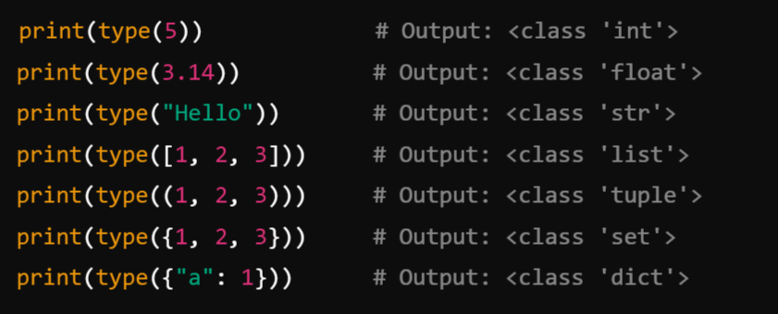
How type() Works:
The function returns the class type of the object. Python uses classes to define its data types, so type() effectively tells you the class to which the object belongs.
Example:

Slide 69
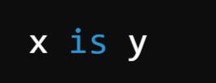
is Operator in Python:
The is operator in Python is used to compare the identity of two objects. It checks whether two variables refer to the same object in memory, not just if their values are equal.
Syntax:
Returns True if both x and y refer to the same object in memory.
Returns False otherwise

Slide 70
Key Points:
1. Identity Comparison:
The is operator checks the identity of the objects using their memory addresses (object IDs).
2. Difference from ==:
is compares the identity of objects.
== compares the values of objects.
Objects with the same value may not have the same identity.
3. Singletons:
The is operator is commonly used to check if an object is a singleton like None

Slide 71
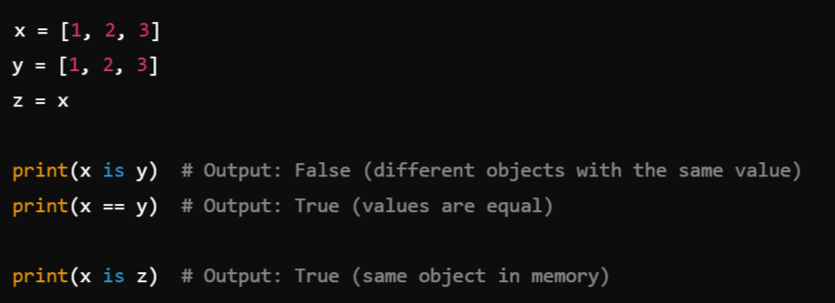
Example:
1. Comparing Identity:

Slide 72
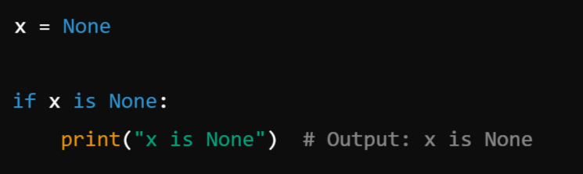
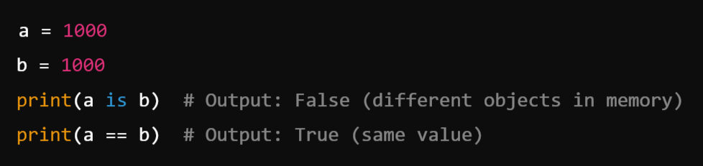
2. Using is with Singletons:
3. Objects with Same Value but Different Identity:

Slide 73
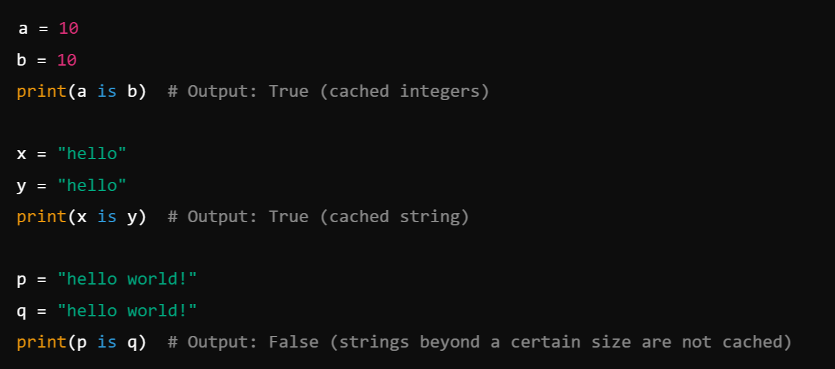
Object Caching in Python:
For some immutable objects (like small integers and strings), Python caches objects to optimize memory usage. For these objects, is might return True for equal values because the same object is reused.
Example:

Slide 74
Indentation in Python:
Indentation in Python is a fundamental part of its syntax. Unlike many other programming languages that use braces {} or keywords like end to define blocks of code, Python uses indentation to represent the hierarchy and grouping of code.
Why Indentation is Important in Python?
Defines Code Blocks:
Indentation is used to define blocks of code, such as the body of loops, functions, conditionals, and classes.
Without proper indentation, Python will throw an error.
2. Improves Readability:
It ensures that code is visually clear and easier to read.
3. Mandatory: Indentation is not optional. Python does not use braces {} to indicate blocks, so proper indentation is necessary.

Slide 75
Type Conversions:
Type conversion, also known as Type Casting, is the process of converting one data type into another. Python provides two main ways to perform type conversions:
1. Implicit Type Conversion (Type Coercion):
Python automatically converts one data type to another when it is safe to do so.
2. Explicit Type Conversion:
The programmer manually converts one data type into another using type conversion functions.

Slide 76
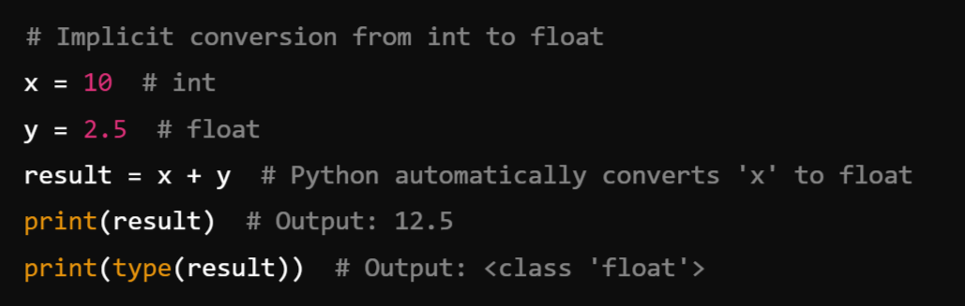
1. Implicit Type Conversion
Python performs implicit conversions during operations where data types are compatible, and no data loss occurs. This usually happens with numeric types like int, float, and complex.
Example:

Slide 77
2. Explicit Type Conversion:
Explicit type conversion is done using Python’s built-in functions. The programmer decides the target type.
Common Conversion Functions:
Function | Converts x To
int(x) | Integer
float(x) | Floating-point number
str(x) | String
list(x) | List
tuple(x) | Tuple
set(x) | Set
dict(x) | Dictionary
bool(x) | Boolean
complex(x) | Complex number

Slide 78
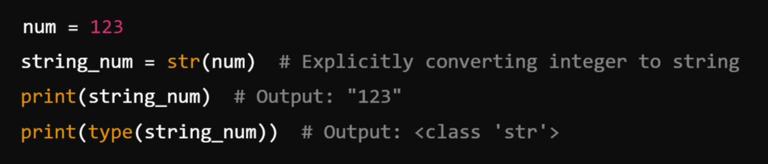
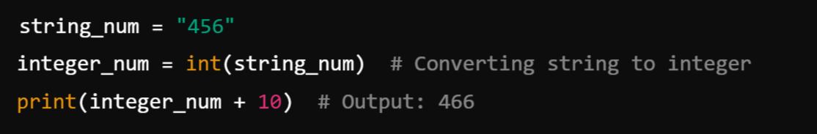
Examples of Explicit Type Conversion
Integer to String:
b) String to Integer:

Slide 79
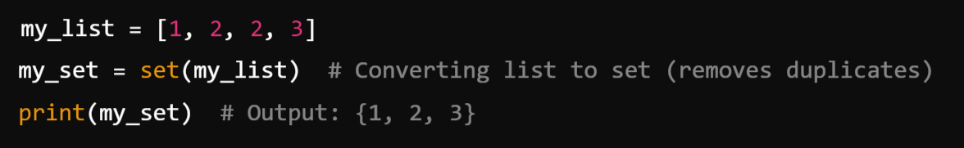
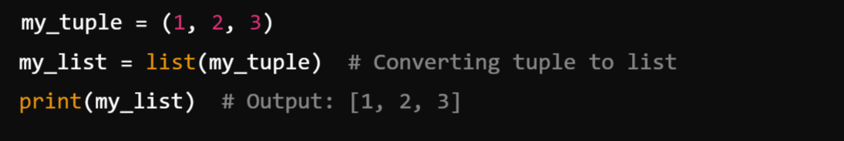
c) List to Set:
d) Tuple to List:

Slide 80
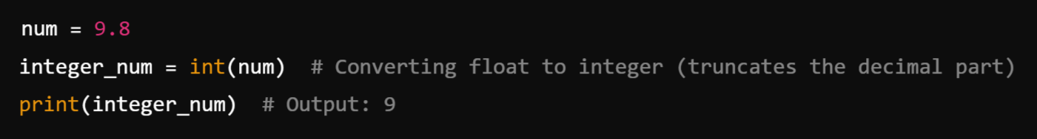
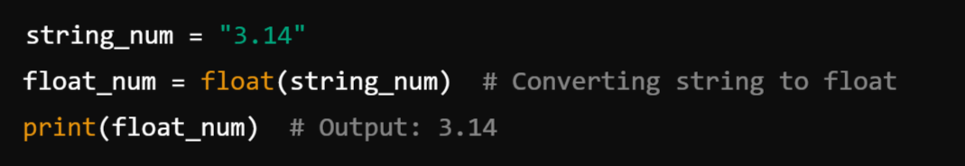
e) Float to Integer:
f) String to Float:

Slide 81
Summary Table of Conversions:
Original Type | Converted To | Conversion Function | Example
int | float | float(x) | float(5) → 5.0
float | int | int(x) | int(3.14) → 3
list | set | set(x) | set([1, 2, 2]) → {1, 2}
tuple | list | list(x) | list((1, 2)) → [1, 2]
str | int | int(x) | int("123") → 123
str | float | float(x) | float("3.14") → 3.14
list | tuple | tuple(x) | tuple([1, 2]) → (1, 2)

Slide 82
Python Program Execution:
In Python, program execution refers to the process by which the Python interpreter processes the code, executes it, and produces the desired output. Here's a step-by-step explanation of how program execution works in Python:
1. Writing the Python Code
A programmer writes Python code in a .py file using a text editor or an Integrated Development Environment (IDE).
The code typically includes variables, functions, classes, control structures, and logic.

Slide 83
2. Interpreted Language:
Python is an interpreted language, which means the code is executed line-by-line by the Python interpreter rather than being compiled into machine code (like C++ or Java).
This makes Python highly portable and easy to debug but sometimes slower compared to compiled languages.

Slide 84
3. Execution Process: Python executes programs in the following stages:
a) Parsing:
The Python interpreter reads the source code and checks it for syntax errors. If any syntax errors exist, execution stops, and the interpreter throws an error.
b) Compilation to Bytecode:
If no syntax errors are found, Python compiles the code into bytecode.
Bytecode is a low-level, platform-independent representation of the source code. It is stored in .pyc files (e.g., in the __pycache__ directory).
Compilation is implicit and happens automatically; you don’t need to do it manually.
c) Execution by Python Virtual Machine (PVM):
The bytecode is passed to the Python Virtual Machine (PVM).
The PVM executes the bytecode line by line and performs the corresponding operations on the system.

Slide 85
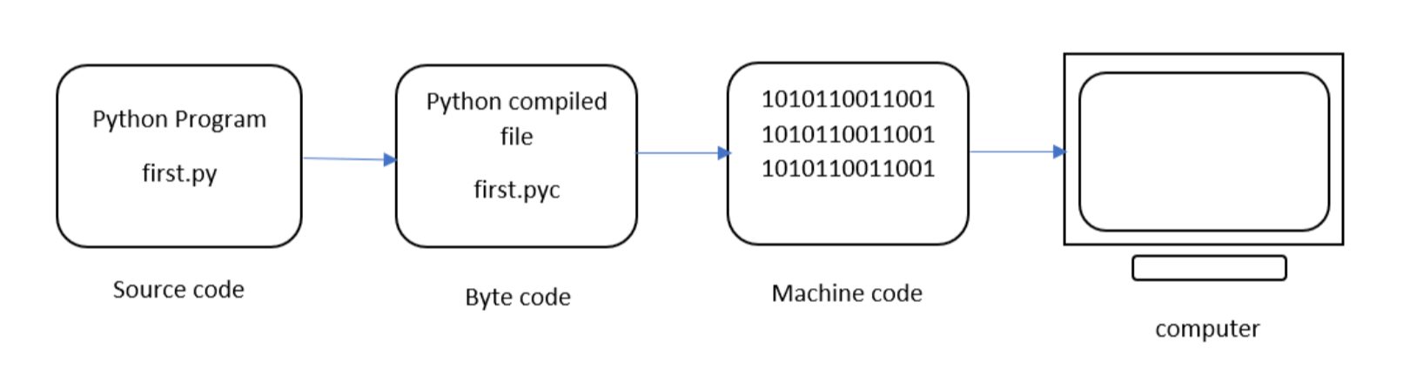
The next step involves converting the byte code (.pyc file) into machine code. This step is necessary as the computer can understand only machine code (binary code). Python Virtual Machine (PVM) first understands the operating system and processor in the computer and then converts it into machine code. Further, these machine code instructions are executed by processor and the results are displayed.
However, the interpreter inside the PVM translates the program line by line thereby consuming a lot of time. To overcome this, a compiler known as Just In Time (JIT) is added to PVM. JIT compiler improves the execution speed of the Python program. This compiler is not used in all Python environments like CPython which is standard Python software.

Slide 86
4. Standard Library and Modules
During execution, Python may load standard libraries or external modules as required by the program.
For example, if you import math, the interpreter loads the math module into the program.
5. Input/Output and Error Handling
As the program runs, it may take inputs from the user, perform computations, and produce outputs (e.g., displaying text on the screen).
If the program encounters errors (like division by zero or accessing an undefined variable), the interpreter throws exceptions and may halt execution unless the errors are handled using try-except blocks.

Slide 87
6. End of Execution
Once all lines of code have been executed, the program finishes.
If the program is a script, it terminates after completing the last statement. If it's an interactive session or service, it may continue running, awaiting further input or requests.

Slide 88

Reading Input:
In Python, reading input refers to the process of taking data (usually from the user) during program execution. Python provides a built-in function called input() for this purpose.
The input() Function Basic Syntax:
prompt: An optional string that is displayed to the user as a message before taking input.
Return Value: The function always returns the input as a string.

Slide 89
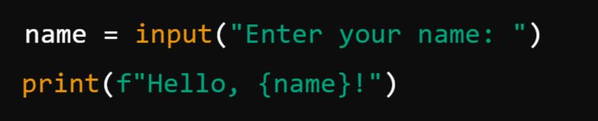
How It Works:
The program pauses and waits for the user to type something.
The user types a value and presses Enter.
The input() function captures the value as a string and stores it in a variable.
Example: Basic Input

Slide 90


2. Input as Numbers:
Since input() returns a string, you need to convert it to the appropriate data type (e.g., int, float) for numeric operations.
3. Input with Multiple Values: You can take multiple inputs in one line by splitting the input string using the split() method.

Slide 91
Print Output:
In Python, printing output refers to displaying text, variables, or results of computations to the console or terminal. The print() function is used for this purpose.
Syntax of print():
Parameters:
*objects: The values or objects you want to display. Multiple items can be separated by commas.
sep: The string inserted between multiple objects (default is a space ' ').
end: The string appended at the end of the output (default is a newline '\n').
file: The output stream (default is sys.stdout, which prints to the console).
flush: A boolean specifying whether to flush the output buffer (default is False).

Slide 92


Example:
Printing Strings:
Printing Variables:

Slide 93


Advanced Features of print()
1. Printing Multiple Values
You can print multiple values by separating them with commas. By default, they are separated by a space.
2. Custom Separator (sep): You can change the separator between multiple values using the sep parameter.

Slide 94


3. Custom End (end) : By default, print() ends with a newline. You can change this using the end parameter.
Output:

Slide 95
Control Flow Statements: (Control the Flow of Execution)
Control flow statements in Python determine the order in which the code is executed. These statements help the program decide whether to execute a particular block of code, repeat a block of code, or jump between blocks based on conditions.
Types of Control Flow Statements
Conditional Statements (Decision-Making)
if
if-else
if-elif-else
Nested if
Looping Statements
for loop
while loop
Jump Statements
break
continue
pass

Slide 96
1. Conditional Statements (Decision-Making):
Conditional statements in Python allow the program to make decisions based on specific conditions. These statements execute certain blocks of code only when specified conditions are met. The main decision-making statements in Python are:
if Statement
if-else Statement
if-elif-else Statement
Nested if Statement

Slide 97


1. if Statement ( Simple If):
The if statement executes a block of code to True. only when the given condition evaluates
Syntax:
Example:
The condition x > 5 evaluates to True, so the indented block is executed.

Slide 98

Simple If Flow Chart

Slide 99


2. if-else statement:
The if-else statement provides two blocks of code: one that executes if the condition is true and another that executes if the condition is false.
Syntax:
Example:
The condition x > 5 evaluates to False, so the else block is executed.

Slide 100

if-else Flow Chart

Slide 101

3. if-elif-else Statement:
The if-elif-else allows for multiple conditions to be evaluated sequentially. The first condition that evaluates to true will have its corresponding block executed, and the rest of the ladder will be skipped. If none of the conditions are true, the else block (if present) will be executed.
Syntax:

Slide 102

Example:

Slide 103

4. Nested if statement:
Nested if statements allow an if statement to be placed inside another if statement. This allows for more complex decision-making processes where multiple conditions must be true for a block of code to execute.
Syntax:

Slide 104

Example:

Slide 105


One-Liner if Statement: Python allows simple if statements to be written in a single line.
Example:
One-Liner if-else Statement (Ternary Operator): The if-else statement can also be written as a one-liner using the ternary operator.
Syntax:
Example:

Slide 106
2. Looping Statements:
Looping statements in Python allow you to execute a block of code multiple times, either for a specific number of iterations or until a certain condition is met.
Python provides two main types of loops:
for Loop
while Loop
Additionally, Python supports jump statements (break, continue, and pass) to control the flow within loops.

Slide 107



1. for loop:
The for loop provides a concise way of writing the loop structure. It is used when the number of iterations is known advance or beforehand.
The for loop is used to iterate over a sequence (e.g., list, tuple, dictionary, string, or range). It executes the block of code once for each element in the sequence.
Syntax:
Example: a) Iterating Over a List: Output:

Slide 108




b) Using range(): The range() function generates a sequence of numbers.
Output:
c) Iterating Over a String:
Output:

Slide 109

for Loop Flow Chart:

Slide 110


2. while loop:
The while loop continually executes a block of code as long as a specified condition is true. The condition is checked before the execution of the loop body, making it a pre-test loop.
The while loop is used when the number of iterations is not known in advance, but the condition is checked before the loop body executes.
Syntax:
Example: Print Num from 0-4:

Slide 111


Using a while Loop with else:
The else block in a while loop executes if the loop completes normally (i.e., not terminated by a break).
Example: Output:

Slide 112


Slide 113


Loops with else
Both for and while loops can have an optional else block that executes if the loop finishes without encountering a break.

Slide 114
3. Jump Statements:
Jump statements in Python are used to control the flow of loops by altering their default behavior.
Python provides the following jump statements:
break Statement
continue Statement
pass Statement
These statements allow you to exit a loop, skip an iteration, or do nothing, respectively.

Slide 115

1. break Statement:
The break statement is used to exit a loop prematurely, regardless of the loop's condition. Once the break statement is executed, the loop terminates, and control moves to the code following the loop.
Syntax:

Slide 116



Examples:
Breaking a for Loop: Output:
Breaking a while Loop:

Slide 117

2. continue Statement:
The continue statement is used to skip the rest of the code in the current iteration and proceed to the next iteration of the loop. The loop does not terminate but continues with the next iteration.
Syntax:

Slide 118



Example:
Skipping an Iteration in a for Loop:
Output:
b) Skipping an Iteration in a while Loop:

Slide 119

3. pass Statement:
The pass statement is a placeholder that does nothing when executed. It is often used when a statement is syntactically required but no action is desired.
Syntax:

Slide 120


Examples
Using pass in an if Statement:
Using pass in a Loop:

Slide 122
Module-1: Python Basic Concepts and Programming :
Interpreter, Parts of Python Programming Language, Identifiers, Keywords, Statements and Expressions, Variables, Operators, Precedence and Associativity, Data Types, Indentation, Comments, Program Execution, Reading Input, Print Output, Type Conversions, The type( ) Function and Is Operator, Control Flow Statements: The if Decision Control Flow Statement, The if…else Decision Control Flow Statement, The if…elif…else Decision Control Statement, Nested if Statement, The while Loop, The for Loop, The continue and break Statements, Sequences – Strings, Built-In Functions, Commonly Used Modules, Function Definition and Calling the Function, The return Statement and void Function, Scope and Lifetime of Variables, Default Parameters, Keyword Arguments, *args and **kwargs, Command Line Arguments.

